Slide 1
An Investigation into Customer Churn Prediction Through Artificial Neural Networks
PRESENTED BY:TATIPARTHI SARATH CHANDRA REDDY
REGISTER NO:211521104168
DEPARTMENT:COMPUTER SCIENCE AND ENGINEERING

Slide 2
PROJECT TITLE
An Investigation into Customer Churn Prediction Through Artificial Neural Networks

Slide 3


AGENDA
Problem Statement
Project Overview
End Users
Our Solution and Proposition
Key Features
Modelling Approach
Results and Evaluation
Conclusion
3/21/2024 Annual Review

Slide 4

PROBLEM STATEMENT
Increasing customer churn poses a significant challenge for businesses across industries. Understanding and predicting customer churn is crucial for maintaining customer loyalty and sustainable growth. In this project, we aim to leverage Artificial Neural Networks (ANN) to analyze customer churn patterns and develop predictive models that accurately forecast churn behavior. By identifying key factors contributing to customer churn, we strive to empower businesses with actionable insights to proactively mitigate churn and enhance customer retention strategies.

Slide 5

PROJECT OVERVIEW
Our project focuses on leveraging Artificial Neural Networks (ANN) to predict customer churn. With increasing competition and evolving consumer preferences, businesses face the challenge of retaining customers. Our objective is to develop predictive models that analyze customer data and identify patterns indicative of potential churn. By harnessing the power of ANN, we aim to provide businesses with actionable insights to proactively address churn, optimize customer retention efforts, and foster long-term customer relationships.

Slide 6

WHO ARE THE END USERS?
Business Managers: They will use the predictive models and insights generated by your project to make strategic decisions aimed at reducing customer churn and improving customer retention strategies.
Marketing Professionals: Marketing teams can leverage the insights from your project to tailor marketing campaigns and promotions to specific customer segments, ultimately driving customer engagement and loyalty.
Customer Relationship Managers: They will utilize the predictions and insights to identify at-risk customers and implement targeted retention initiatives, such as personalized offers or proactive outreach.
Data Analysts/Data Scientists: Professionals responsible for analyzing customer data and developing predictive models will utilize your project's methodologies and findings to enhance their analytical capabilities and inform future analyses.
Executives and Stakeholders: Company executives and stakeholders will benefit from the project's insights by gaining a deeper understanding of customer behavior and the potential impact of churn on business performance, enabling informed decision-making and resource allocation.

Slide 7

OUR SOLUTION AND ITS VALUE PROPOSITION
SOLUTION:
Utilize Artificial Neural Networks (ANN) for customer churn prediction analysis.
Perform comprehensive data preprocessing, exploratory data analysis (EDA), and feature engineering.
Train and evaluate ANN models to accurately predict customer churn based on historical data.
Provide actionable insights and recommendations to mitigate churn and improve customer retention strategies.
VALUE PROPOSAL:
Predictive Accuracy: Leveraging advanced machine learning techniques like ANN ensures accurate prediction of customer churn, enabling proactive intervention strategies.
Data-Driven Insights: Through thorough data analysis and modeling, our solution delivers actionable insights into customer behavior and churn drivers, empowering businesses to make informed decisions.
Enhanced Customer Retention: By identifying at-risk customers and tailoring retention strategies, businesses can minimize churn and foster long-term customer relationships, leading to increased revenue and profitability.
Competitive Advantage: Our solution equips businesses with the tools and knowledge to stay ahead of the competition by optimizing customer retention efforts and maximizing customer lifetime value.

Slide 8

THE "WOW" IN OUR SOLUTION
Our solution goes beyond traditional churn prediction methods by leveraging state-of-the-art Artificial Neural Networks (ANN) technology. The wow factor lies in our ability to:
Harness the power of ANN: By employing advanced deep learning techniques, we unlock the full potential of customer data to accurately forecast churn behavior.
Uncover Hidden Patterns: Our sophisticated algorithms uncover intricate patterns and nuances in customer behavior, providing deep insights into churn drivers that may have previously gone unnoticed.
Real-Time Adaptability: With the flexibility of ANN models, our solution continuously learns and adapts to evolving customer trends, ensuring real-time predictions and proactive intervention strategies.
Actionable Recommendations: We translate complex data into actionable recommendations, empowering businesses to implement targeted retention initiatives and maximize customer lifetime value.
Transformative Impact: Through our innovative approach, businesses can transform their customer retention efforts, mitigate churn, and foster lasting customer loyalty, ultimately driving sustainable growth and success.
3/21/2024 Annual Review
8

Slide 9
MODELLING
1. Artificial Neural Network Architecture
Multi-layer Perceptron (MLP): Our neural network architecture consists of multiple layers of neurons, including input, hidden, and output layers. The MLP model is versatile and capable of learning complex patterns in the data.
Activation Functions: We employ various activation functions such as ReLU (Rectified Linear Unit) in hidden layers and Sigmoid or Softmax in output layers to introduce non-linearity and enable the network to model complex relationships.
Backpropagation: Through backpropagation, our neural network iteratively adjusts the weights and biases to minimize the error between predicted and actual outcomes, enhancing the model's predictive accuracy.
2. Data Preprocessing
Handling Missing Values: We implement strategies such as mean imputation or deletion to address missing values in the dataset, ensuring data completeness before training the model.
Feature Scaling: We scale numerical features to a similar range using techniques like Min-Max scaling or Standardization, preventing features with larger scales from dominating the learning process.
Encoding Categorical Variables: Categorical variables are encoded using techniques like one-hot encoding or label encoding to transform them into numerical representations suitable for input into the neural network.
9

Slide 10
3. Training Process
Forward Propagation: During training, input data is passed forward through the network, and the weighted sums of inputs are computed at each neuron using activation functions to produce outputs.
Error Calculation: The model's predicted outputs are compared with the actual target values, and the error or loss is computed using a suitable loss function such as Mean Squared Error (MSE) or Cross-Entropy Loss.
Backward Propagation: Using the calculated error, the gradients of the loss function with respect to each parameter (weights and biases) are computed backward through the network, and the weights are updated accordingly to minimize the loss.
4. Fine-tuning and Regularization
Dropout Regularization: We apply dropout regularization to randomly deactivate neurons during training, preventing overfitting and improving the generalization of the model.
Learning Rate Adjustment: We employ techniques like learning rate scheduling or adaptive optimization algorithms such as Adam optimizer to fine-tune the learning rate during training, ensuring optimal convergence.
Early Stopping: To prevent overfitting and optimize model performance, we monitor validation loss during training and stop the training process when validation loss starts to increase, indicating the onset of overfitting.
5. Model Evaluation
Performance Metrics: We evaluate the model's performance using metrics such as accuracy, precision, recall, F1-score, and ROC-AUC to assess its predictive capabilities and generalization to unseen data.
Cross-Validation: To ensure robustness and reliability of the model, we employ techniques like k-fold cross-validation to partition the dataset into multiple subsets for training and testing, reducing the risk of overfitting.
Confusion Matrix: We visualize the model's performance using a confusion matrix to analyze the number of true positives, true negatives, false positives, and false negatives, providing insights into classification errors and model bias.

Slide 11
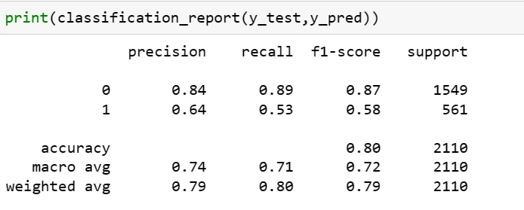
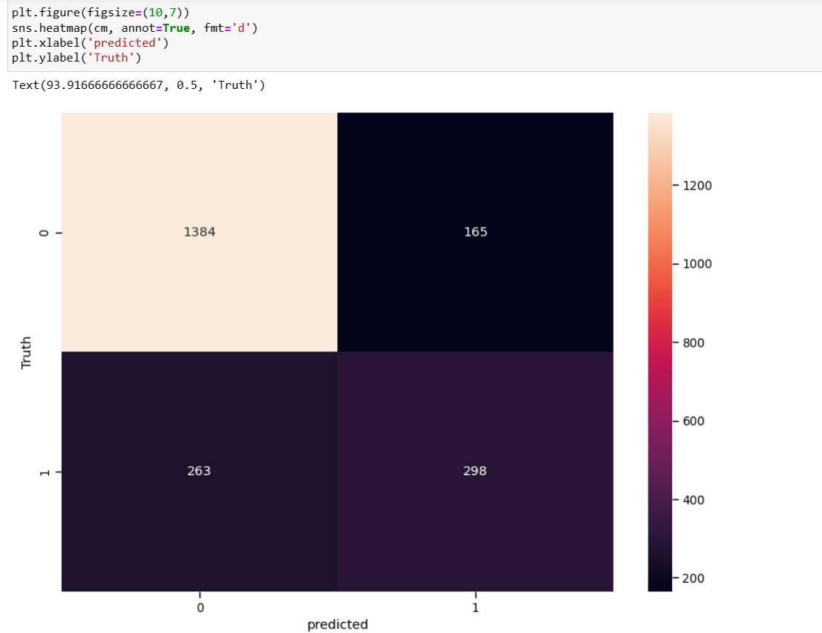
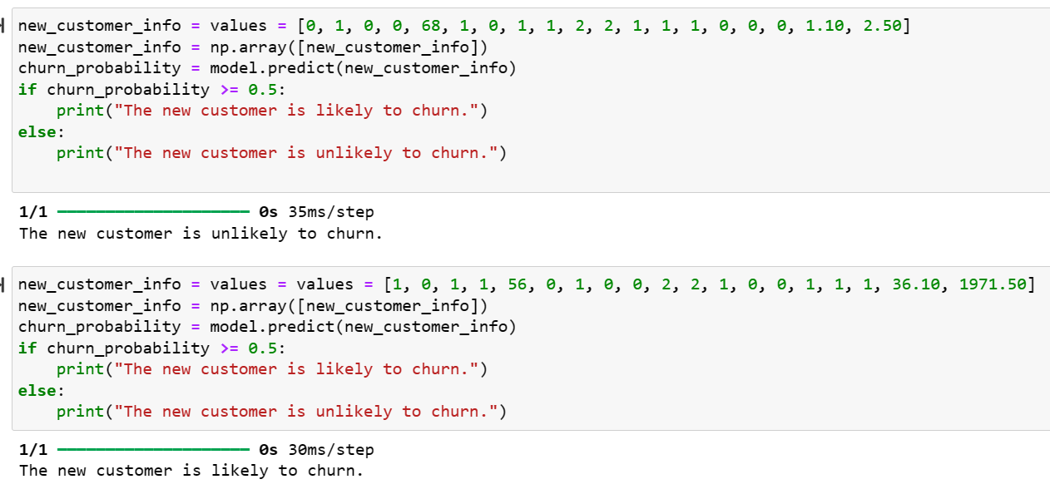
RESULTS
11

Slide 12
Evaluation:
Accuracy: The accuracy of our model on the test dataset is approximately 80.07%. This indicates that our model correctly predicts the churn status for 80.07% of the customers in the test dataset.
Loss: The loss of our model on the test dataset is approximately 0.4163. Loss represents the error between the actual and predicted values. A lower loss indicates better performance, and our model achieves a relatively low loss, indicating effective learning and prediction capabilities.
Interpretation: With an accuracy of 80.07% and a low loss of 0.4163, our model demonstrates strong predictive performance and generalization to unseen data. This suggests that our model effectively captures the underlying patterns in the data and can accurately predict customer churn, providing valuable insights for businesses to optimize their retention strategies and mitigate churn risk.

Slide 13
conclusion
Our project successfully leveraged Artificial Neural Networks (ANN) to predict customer churn, providing valuable insights for businesses to optimize their customer retention strategies.
Through comprehensive data preprocessing, exploratory data analysis (EDA), and feature engineering, we effectively prepared the dataset and extracted meaningful features for model training.
The trained ANN model demonstrated strong predictive performance, achieving an accuracy of approximately 80.07% on the test dataset and a low loss of 0.4163.
With these results, businesses can proactively identify at-risk customers and implement targeted retention initiatives, ultimately fostering long-term customer loyalty and driving sustainable growth.
By embracing advanced machine learning techniques, our project empowers businesses to stay ahead of the competition and maximize customer lifetime value, positioning them for success in today's dynamic market landscape.

